Slide 1
Hotel Bookings cancellation
Rehab Alanazi

Slide 2
Table of Contents
01
Visualization
The problem
04
02
Data Model
Dataset
05
Data Cleaning
Conclusion & Tools
03
06

Slide 3


01
The problem

Slide 4
There are a lot of people who need to stay in hotels for many reasons, including work or a pleasant vacation with family, and there are also many reasons that can influence the decision to stay at the hotel or cancel the booking. By analyzing the previous data of hotel bookings, we may predict if the customer will cancel or confirm a booking.

Slide 5

01
02
03
04
The purpose of the model I build it is to predict the possibility of canceling
a hotel booking.
It will be useful for hotel managers to know the probability of cancelation for each customer.
This will allow them to make actions to increase the probability of booking confirmation.
such as reminding or calling the customers with high probability
of canceling first
In case of no response, they can make the booked room
available if the customer is late a few hours

Slide 6
02
Dataset

Slide 7
Hotel Booking Demand Dataset provided by Kaggle website
4
2
3
The target I want to predict is “is_cancele”.
1
contains 32 features
The individual sample is user booking information for one customer.
contains 119390 data points

Slide 8

03
Data Cleaning

Slide 9
Cleaning data
01
02
03
Missing
Names
Unnecessary
Filling the missing value
Rename some features
Drop the unnecessery features
04
05
06
Duplicate
Type
Converting
Remove duplicate data
Rtype some features type
Converting categorical features into numerical features

Slide 10

04
Visualization

Slide 11
Explore the features that led the customer to stay at the hotel or cancel the booking
Exploring Data Analysis
(EDA)

Slide 12
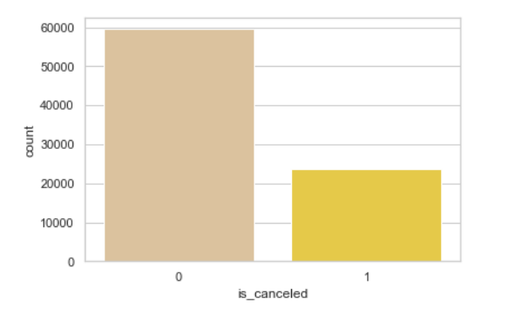
This chart shows there is unbalance between in the dataset so, in preprocessing part I will balance between them

Slide 13
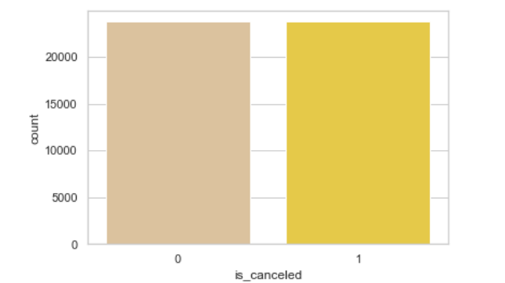


After balancing data

Slide 14
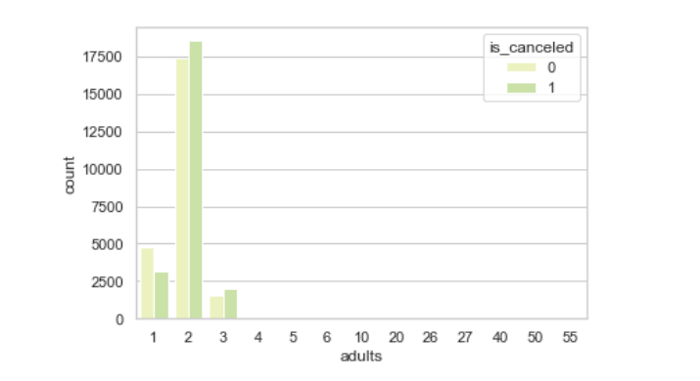



When the number of adults 2 is often tend to cancel the booking, Whereas when one person doesn't tend to cancel.

Slide 15
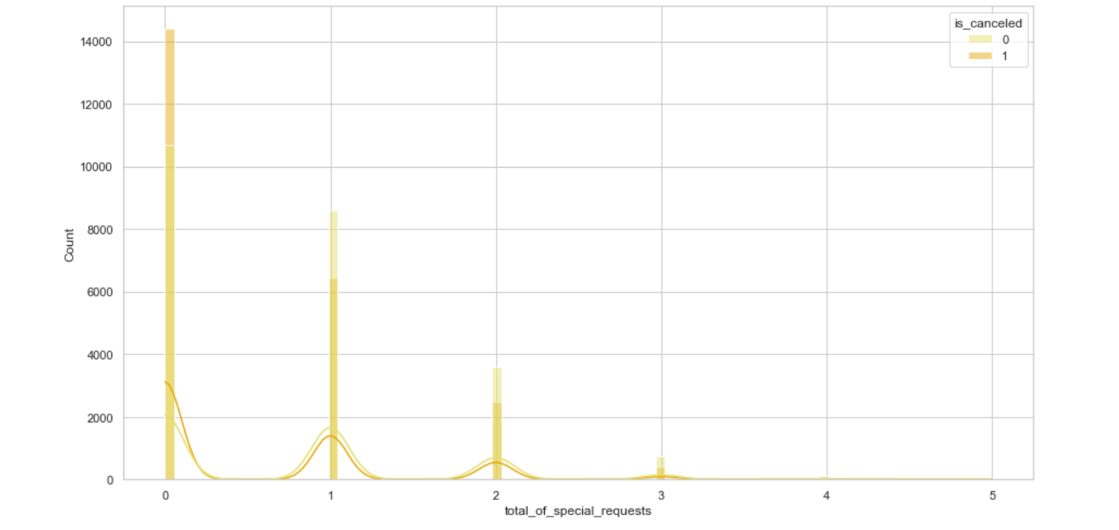
Customers who don't have special requests are the highest, but they often tend to cancel, while those with special requests often don't tend to cancel.

Slide 16
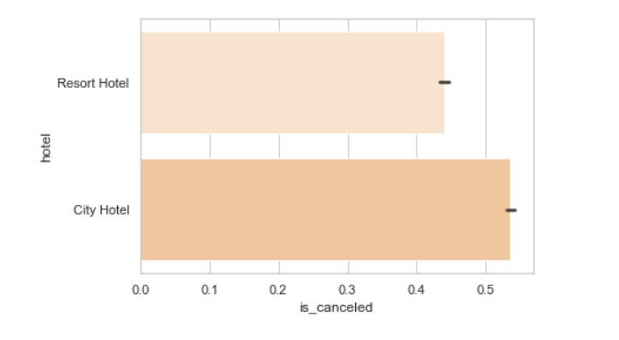
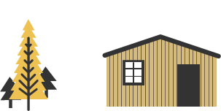

Customers in the City Hotel tend to cancel more often.

Slide 17
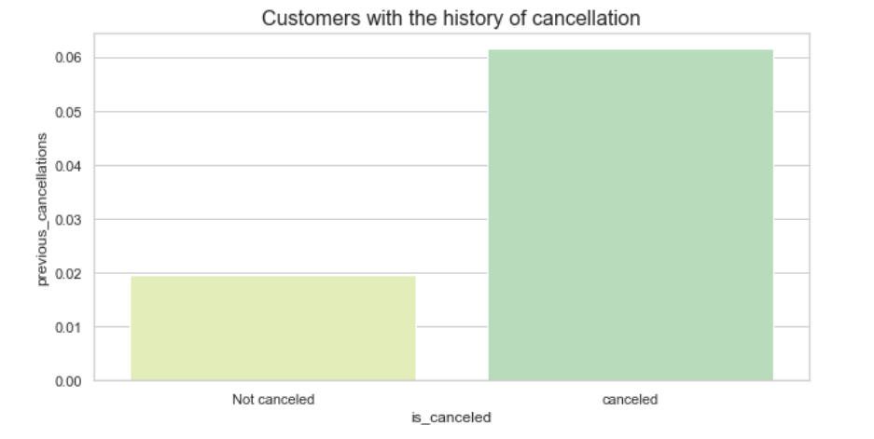




Customers with the history of cancellation tend to cancel more often.

Slide 18
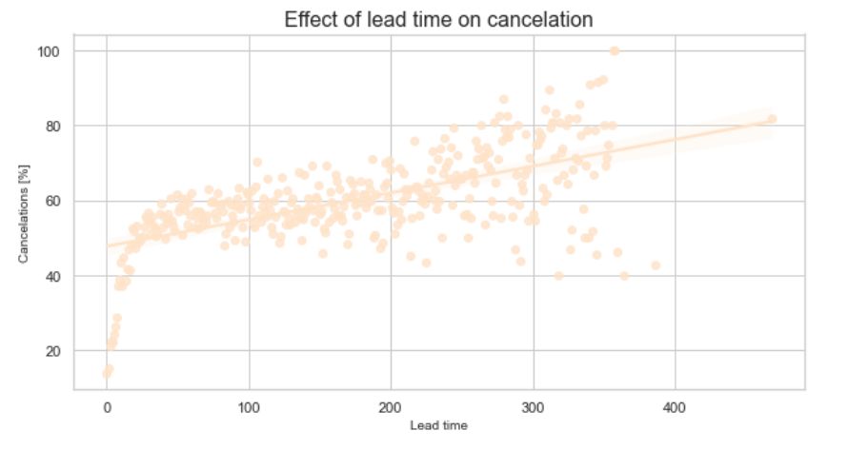









25 Days
4 Days
Bookings made a few days before the arrival date are rarely canceled, whereas bookings made over one year in advance are canceled very often.
42 Days

Slide 19


05
Data Model

Slide 20
The Model Used
01
02
03
Logistic Regression
Decision Tree
Random Forest

Slide 21
Comparison Models
 | Logistic Regression | Decision Tree | Random Forest
Accuracy | 58% | 78% | 83%
Recall | 0.65 | 0.77 | 0.82
Precision | 0.57 | 0.78 | 0.83

Slide 22
06
Conclusion

Slide 23
Random Forest Model
Is the best model to predict the possibility of canceling a hotel booking

Slide 24
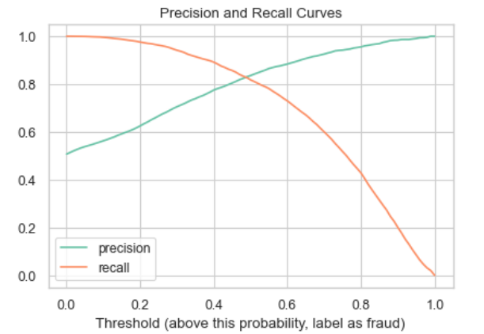
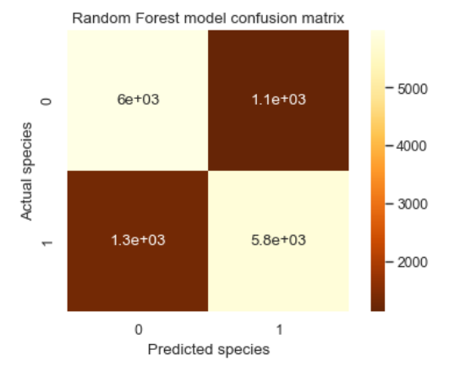
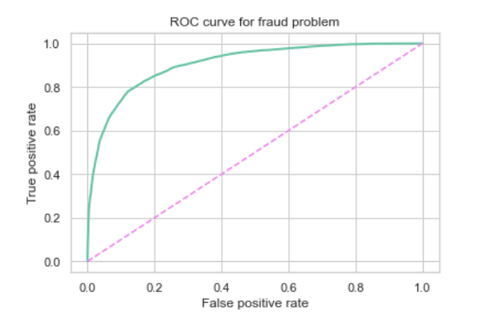

Slide 25
06
Tools

Slide 26
Tools Used
For Data Processing
For Building The Model
For Visualization
Pandas, NumPy
Scikit-learn library
Matplotlib

Slide 27



Thanks!
Do you have any questions?

